Slide 1
Analysis of Consumer Complaint Data
Bureau of Consumer Financial Protection
Group 4: Yihui Yang, Jiarun Li, Baiting Gai, Shuang Wu, Ziyi Zhang, Xiuqi Wang

Slide 2
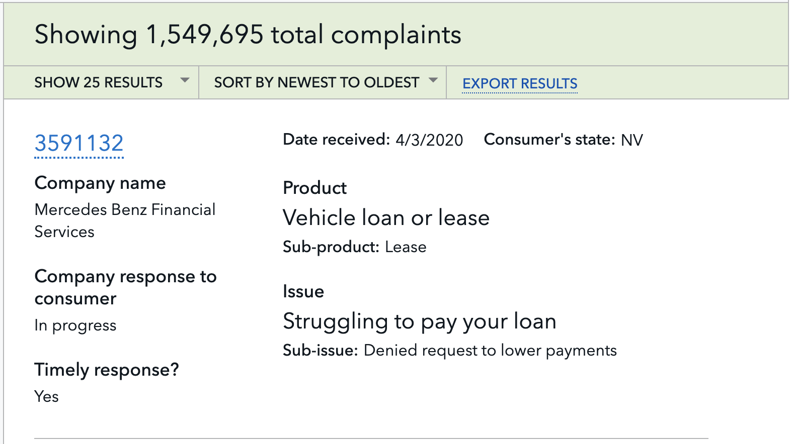

Consumer Complaint Database
Notes:
Complaints act as feedback from end points in the marketplace and play an integral role
Our data comes from CFPB database. We have more than 1.5 million records in our dataset and we are doing analysis from above dimensions, such as

Slide 3
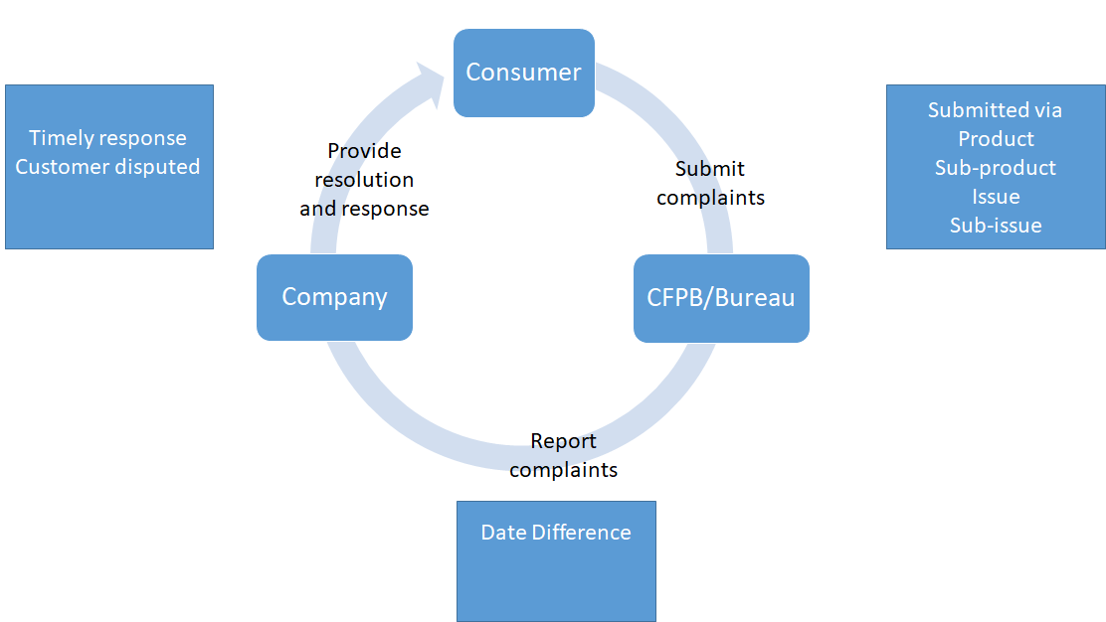
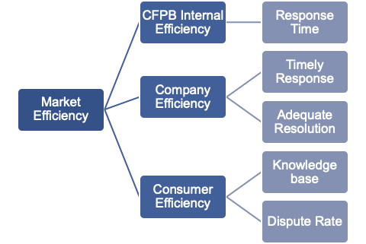
Problem Statement
Problem Statement
Improve overall efficiency in the marketplace
Decrease the number of complaints
Notes:
By conducting the analysis, we are going to provide proposals to solve two problems
first, how to improve
second, how to decrease
Before any analytics, let us give a context of how the market works.
There are three key players in the
hereby, in order to improve

Slide 4
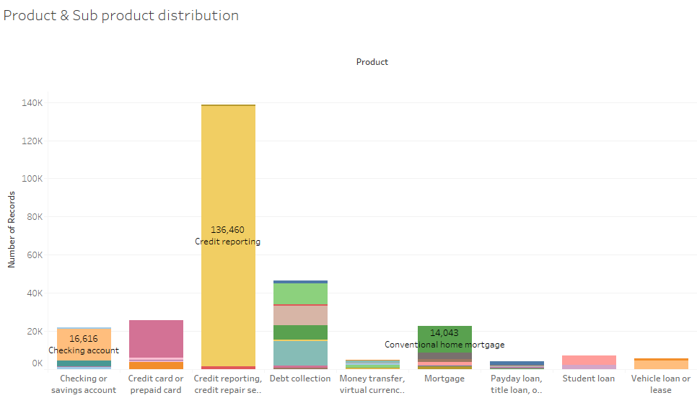
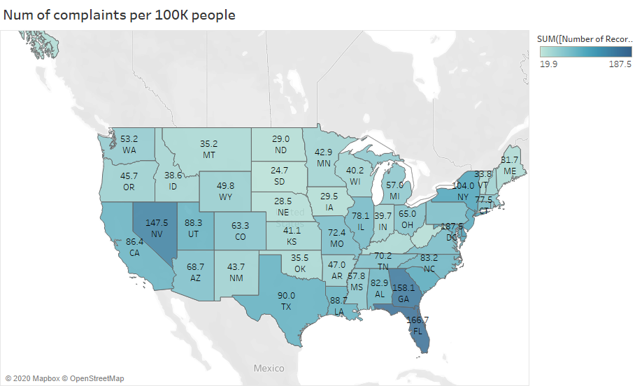
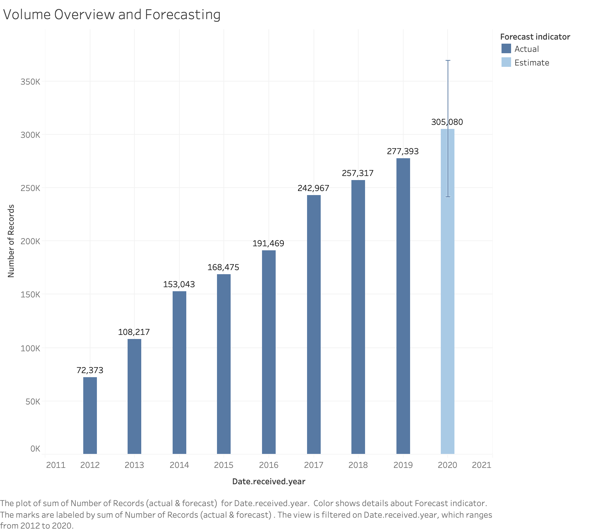
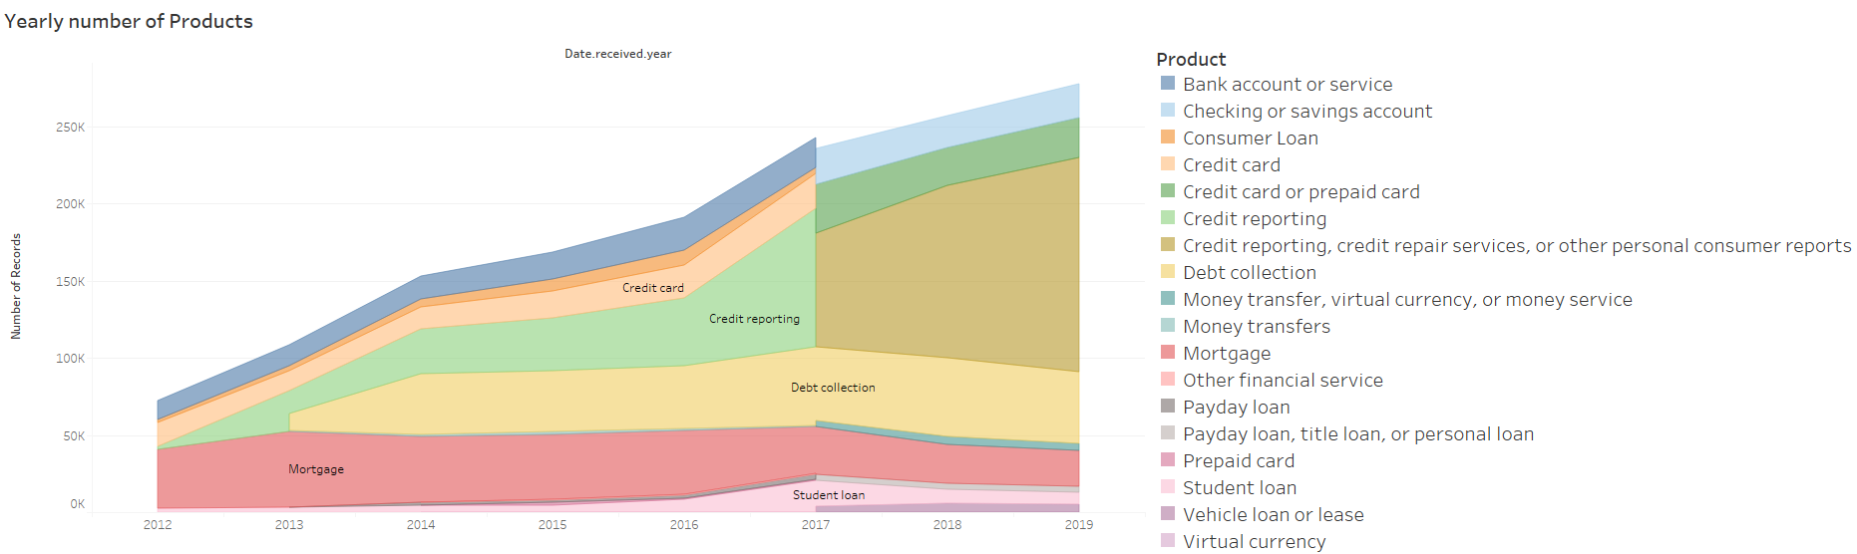
Minitoring Volume of Complaints Over Time

Slide 5
Key Assumptions
Customer disputed rate ~ Consumer Satisfaction
Evaluation of effectiveness of complaints handling
The number of Complaints ~ Company Size
Evaluation of company size difference of complaints resolution
Date difference between date received and date forwarded to company
Evaluation of CFPB internal efficiency

Slide 6
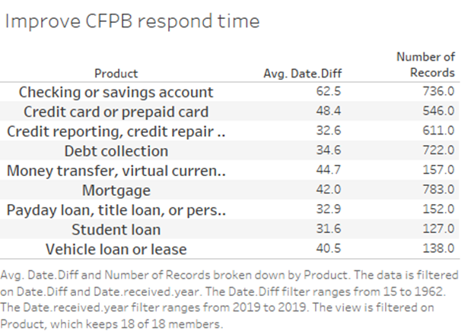
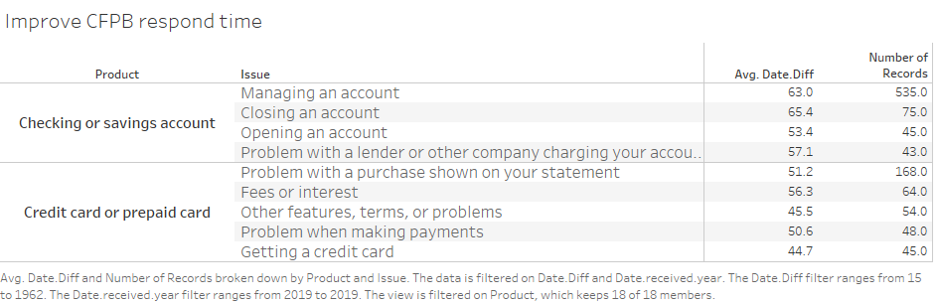
CFPB - Internal Efficiency
Notes:
>15 anormality

Slide 7
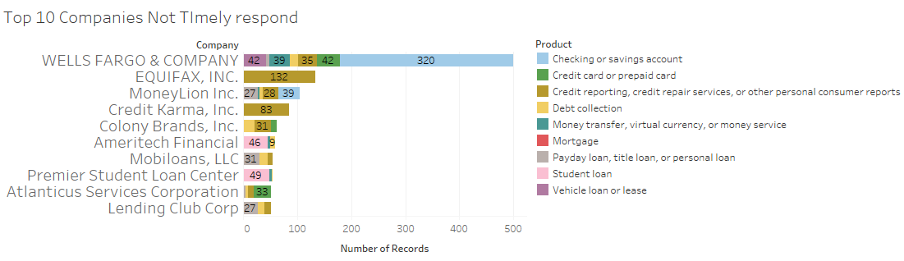
Financial service & product providers - Response Efficiency
Timely Response

Slide 8
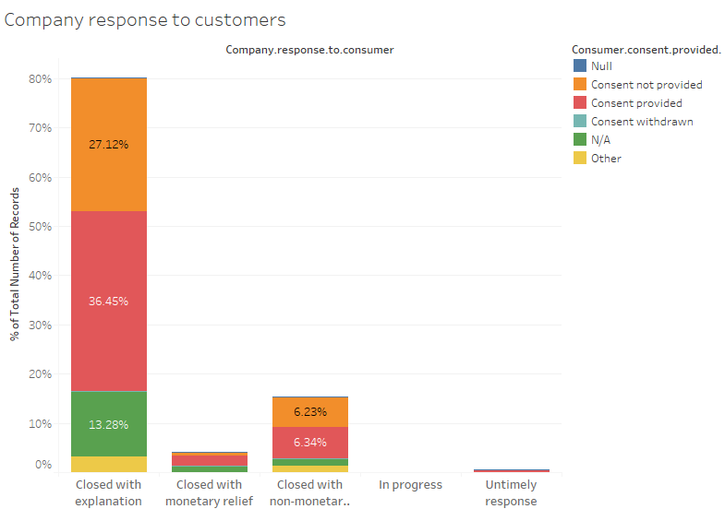
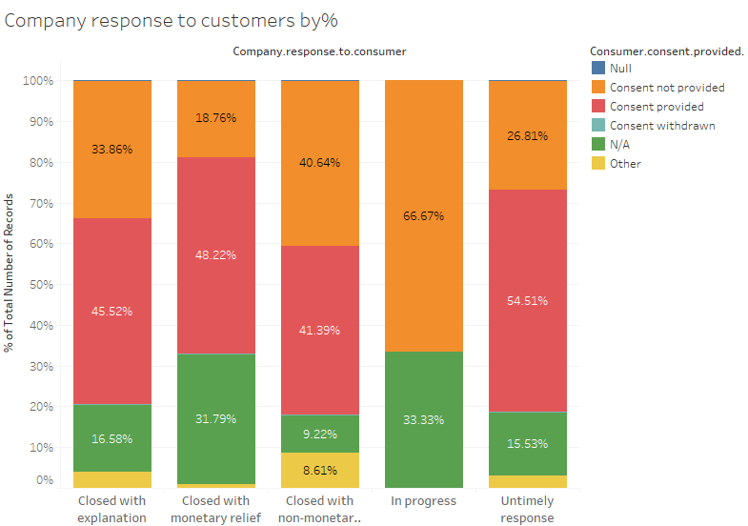
Financial service & product providers - Response Efficiency
Proper Resolution

Slide 9
Problems found based on Data Analysis

Slide 10
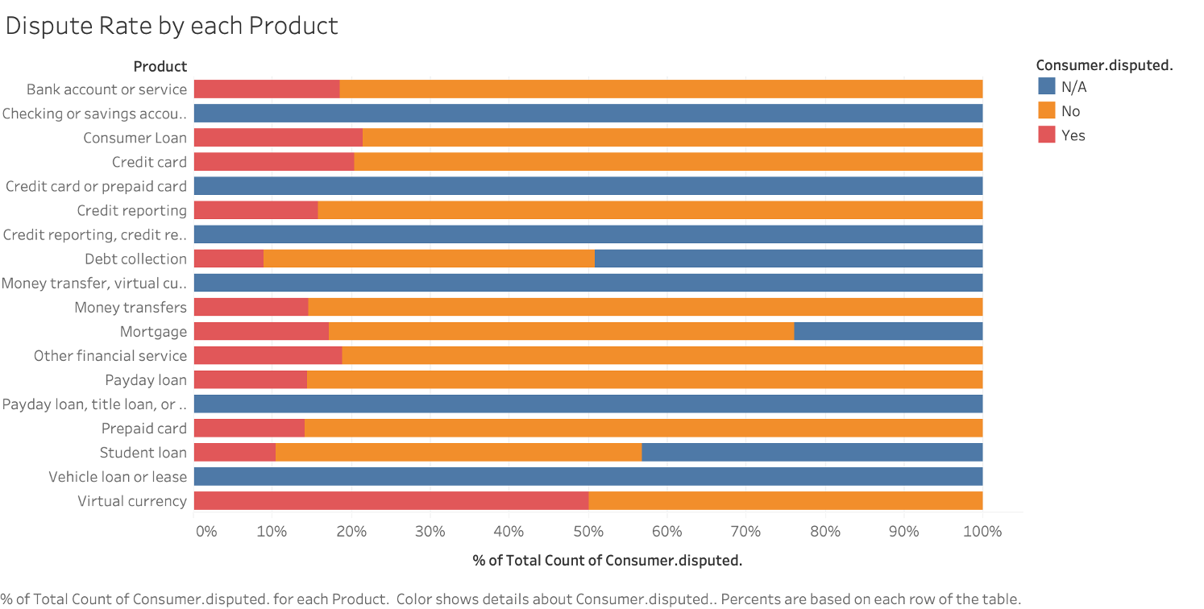
Monitoring on new-categorized products
No follow-up on complaints about products in renewed categories.
Notes:
New products after reclassification, such as “ credit card or prepaid cards”, “ checking or saving accounts”, “vehicle loan or lease”, has an 100% N/A records of consumers disputed, which indicates bcfp didn’t do a good job in following the process of new products. The reason could be the regulatory process or system that hasn’t been updated in time. The emerging service like virtual currency also has a high portion (50%) of disputed rate compared to the traditional financial services. BCFP needs to keep an eye on the trends in the market and take some efforts to improve the industry service level for the new products.

Slide 11
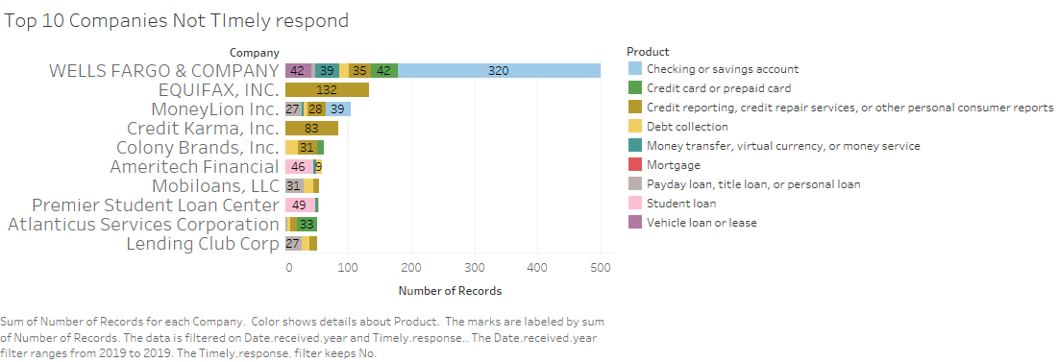
2. High untimely response

Slide 12
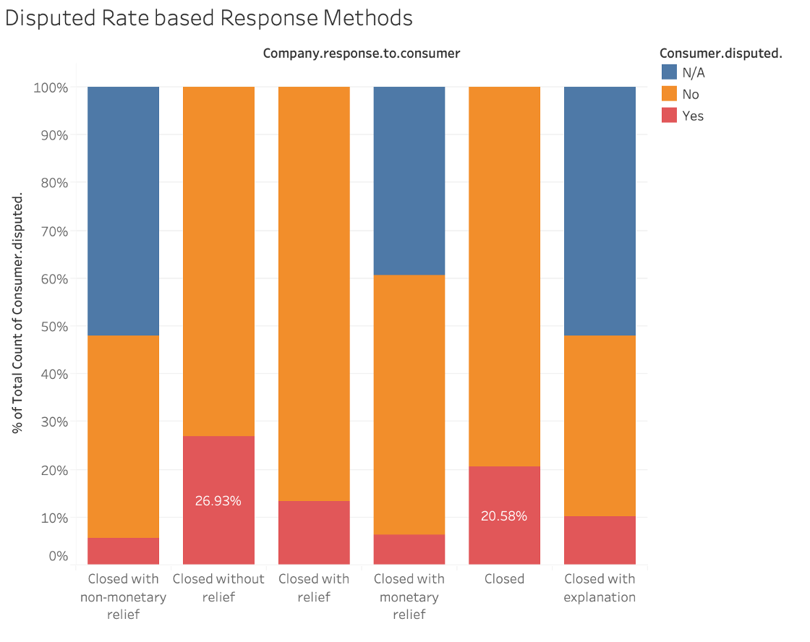
Disputed Rate based on Response Methods
3. Compliant handling
Complaints being closed without any explanation or relief have the lowest customer satisfaction.
Notes:
The customer’s satisfaction about the responses varies as the different solutions of complaints are provided. The “closed” and “closed without relief” are the two reponse with the highest disputed rate, both above 20. Companies are closing complaints without giving any explanation or compensation. No wonder some consumers would dispute the issues and seek for better solutions. It is recommended that bcfp should set some standards for solutions of different types of issues to provide guides for the financial institutes. And required conditions should be met before companies close the complaint status.

Slide 13
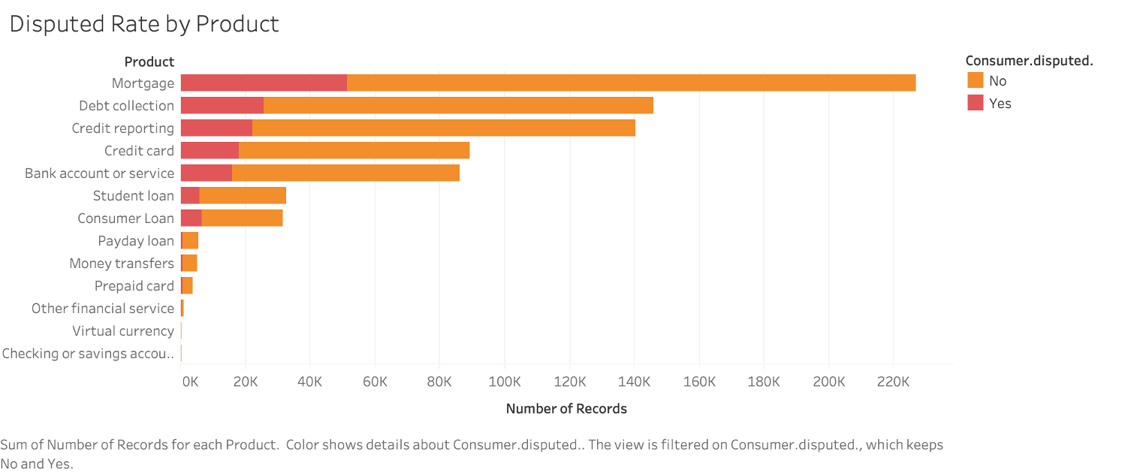
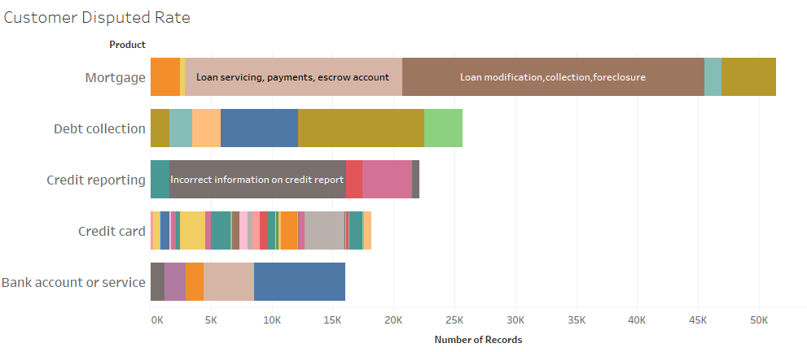
Disputed Rate based on Response Methods
4. Consumer’s knowlege on Financial products

Slide 14
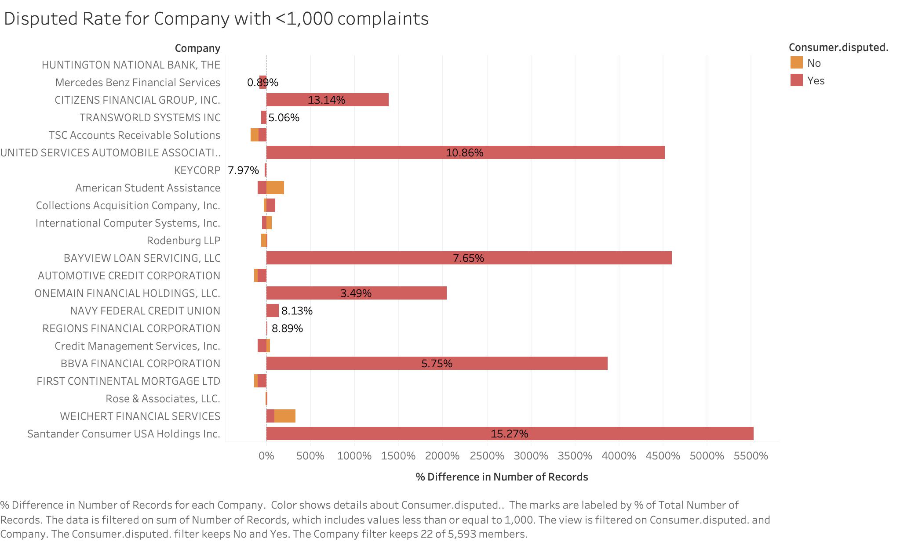
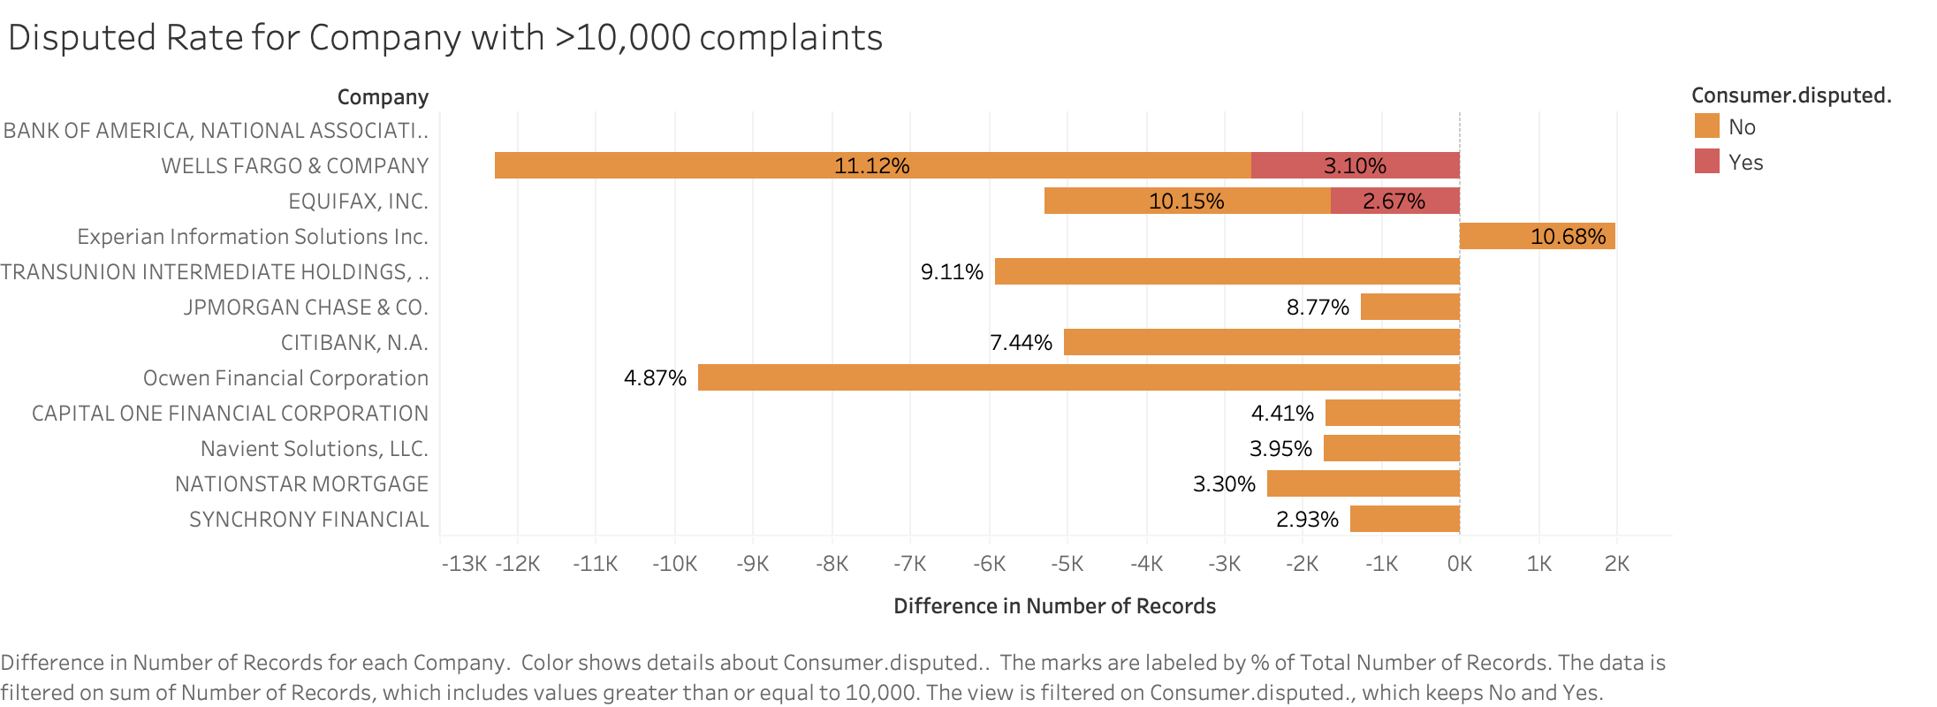
55. Gap between large and small companies
Notes:
Disputed Rate by different size of company( if big companies are doing better than smaller companies)

Slide 15

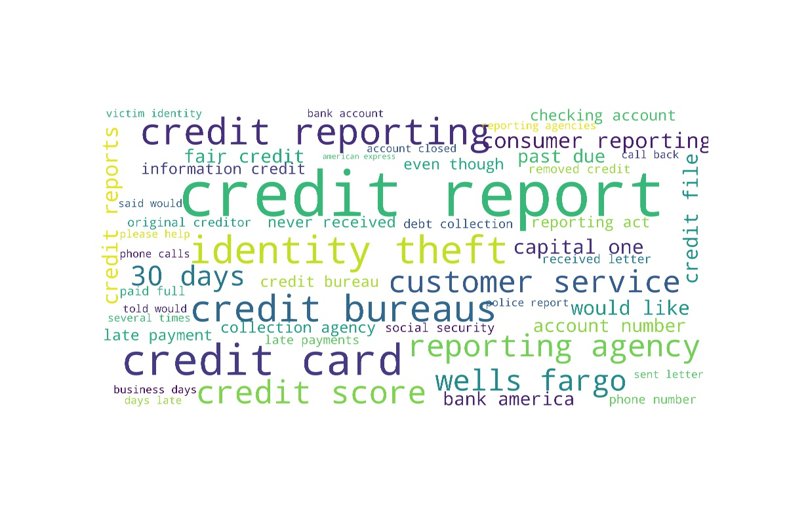
Wordcloud
6. Legislation on preventing identity theft
Randomly select 20000 complaints from year 2018 and 2019
Get rough impression of top areas from unigram word cloud
Top issues include ‘credit report’ and ‘credit card’, ‘theft issue’ and ‘customer services’ in the bigram
Unigram
Bigram

Slide 16
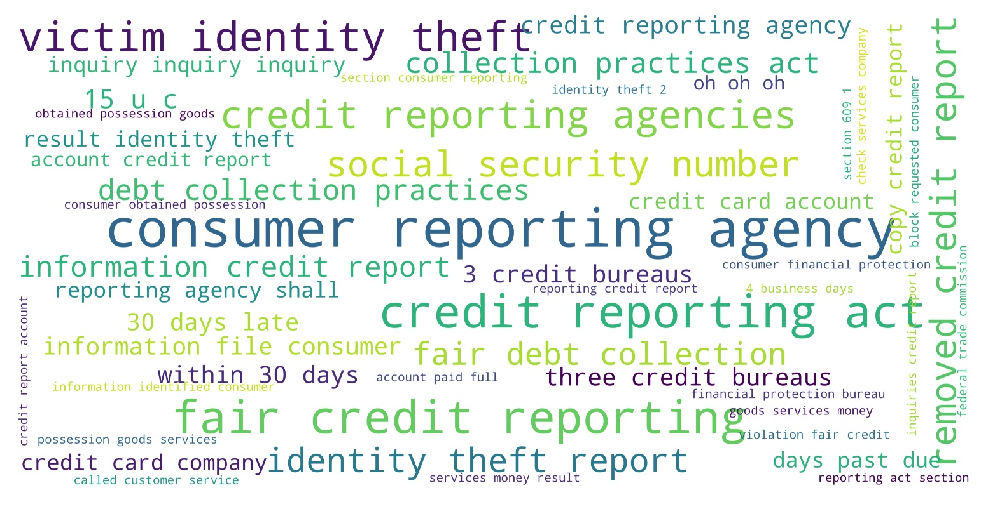
Top two issues: ‘credit reporting’ and ‘identity theft’
Corresponding to previous analysis, credit reporting issues are most frequently mentioned
Many people complain about becoming the victim of identity theft
More rules are needed to confirm identity and restrict personal information leakage
Trigram

Slide 17
Proposals to decrease complaints and improve efficiency
Enhance monitoring on new-categorized and emerging products/services
Requirements for supporting procedure/system updates when updating product catalog
Regulations to decrease untimely response rate
Set upper limit
Information transparency --blacklist of companies with high untimely-response rate
Legislation on complaint handling
Complaint Close Procedure
Consumers education and training
Regulations to improve small companies’ effectiveness
Industry Seminar/ coaching
Required training for complaint handling personnel
Legislation on preventing identity theft

Slide 18



